Slide 1
Social Media Analytics
ADVANCED SOCIAL,
TEXT AND MEDIA ANALYTICS
UNIT – III
DEPARTMENT OF CSBS

Slide 2
UNIT – III
Social Media Analytics: Social network and web data and methods. Graphs and Matrices. Basic measures for individuals and networks. Information visualization;

Slide 3
What is Social Media?
Social Media is a trendy way of electronic communication through which we can create our online communication sites to share information, images, ideas, audios, videos, and other content with our friends, business partners, relatives, as well as customers.
In simple words, we can say that social media is all about establishing communication between marketers and customers.

Slide 4
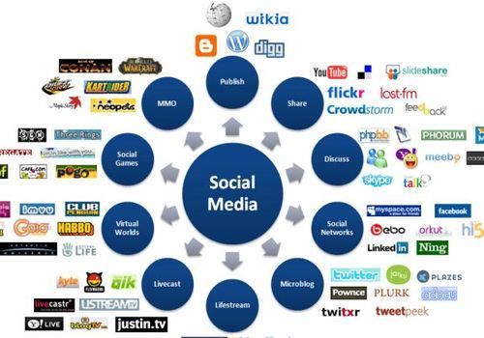
Massively multiplayer online game

Slide 5
What is Social Media Analytics?
Social media analytics is the process of collecting and analyzing audience data shared on social networks to improve an organization's strategic business decisions.
(or)
Social Media Analytics is the art and science of extracting valuable insights from vast amounts of semi-structured and unstructured social media data to enable informed and insightful decision-making.

Slide 6
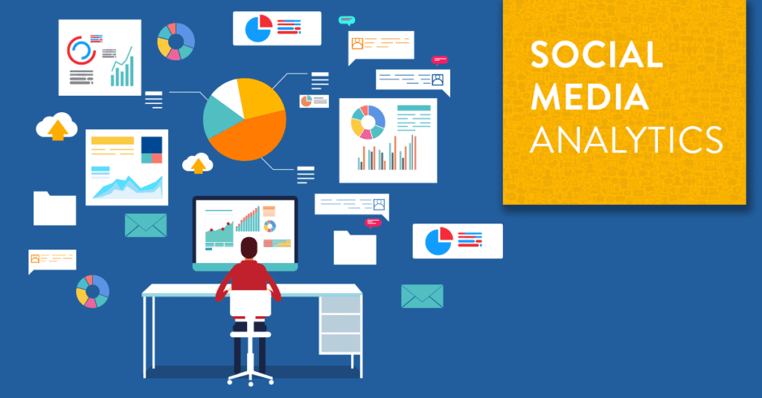

Slide 7
What is Social Media Analytics?
Social media analytics is defined as the process of collecting unstructured data from social media platforms to derive valuable customer and behavioral insights that support critical business decision-making and social media campaigns.
(Or)
Social media analytics is the process of collecting data from social media networks and gaining insights in order to improve the performance of social media campaigns.

Slide 8
Cont ..
Social media analytics goes beyond broader metrics such as likes, follows, clicks, retweets, previews, and impressions gathered from social networks.
As you know, social media is about people sharing their lives with others. With social media analytics, marketers get a peek into users’ lives and fetch valuable data to understand them better based on their interests, behaviors, and even demographics.

Slide 9
Cont ..
Social media analytics tools perform these analysis with the use of technologies such as data mining, data analytics, and big data.
Social analytics is the key to ensure high-level performance of your social media campaigns, and also to make data-driven decisions. It helps your social media team learn what works and what does not work when it comes to content and strategy.
This analysis is based on the level of audience engagement, conversion, and outreach.

Slide 10
Social Media Classification Tools
1. Social Publishing
Social publishing allows us to publish information in the content form (written text and videos).
Example: Blog, YouTube.
2. Social Networking
Social Networking helps us to stay connected with our friends, business partners, relatives, and customers.
Example: LinkedIn, Twitter, Facebook
3. Photo-based Social Networking
Photo-based social networking is used to share photos using social networking sites.
Example: Pinterest, Snapchat, Instagram

Slide 11
Why Social Media Analytics are Important
There are many avenues to be explored via social analytics insights. In fact, the insights found through social media analytics can inform every part of brand operations. Here are six examples:
Increase Customer Acquisition
Protect Brand Health
Lower Customer Care Costs
Maximize Product Launches
Boost Campaign Performance
Improve Crisis Management

Slide 12
Social media analytics Vs Web analytics
The main difference between the two is that social media analytics collects demographic and behavioral data from social media networks, while web analytics gathers data from a particular business website.
In other words, web analytics measure your website’s traffic to give you insights into how users are interacting with your website. Whereas social media analytics gathers information from social channels to help businesses make sense of users’ attitudes and customer sentiments.

Slide 13
What is Social Network?
Social network is a website that brings people together to talk, share ideas and interests, or make new friends.
Examples are: Facebook, Twitter, Linkedin, Instagram, etc.,

Slide 14
Why do people use social networks?
Social networks help people keep connected with their friends and family and are an easy way to find what everyone is doing.
Social networks can also be used to find interesting things on the Internet as your friends and family likely share many of your interests.

Slide 15
What was the first social media website?
The Bolt.com social networking website was created in 1996, by Jane Mount and Dan Pelson. Although it is not considered the first true social media website, it technically was the first to be created. It was officially shut down in October 2008.
The first true social media website is considered to be SixDegrees.com, created in 1997 by Andrew Weinreich. SixDegrees.com is still in operation today, and is available at http://sixdegrees.com

Slide 16
Why is social networking important?
Social networking continues to play an important role in business and individual careers. Here are some reasons social networking remains important:
It connects people and businesses
It helps businesses create advertisements
It allows people to share information
It facilitates instant communication

Slide 17
Pros and cons of social networks
Social networks can be useful tools, but offer both pros and cons to their users. Here are examples of both:
Pros of social networks:
1. Faster communication
2. More connections
3. Better advertising
Cons of social networks:
1. Potential misinformation
2. Less privacy for users
3. Mental health concerns
https://www.indeed.com/career-advice/finding-a-job/social-networking

Slide 18
Formal Methods for Social Networks
Social Network Analysis (SNA) is the use of graph-theoretic and matrix algebraic techniques to study social structure and social relationships.
One reason for using mathematical and graphical techniques in social network analysis is to represent the descriptions of networks compactly and systematically.
A related reason for using (particularly mathematical) formal methods for representing social networks is that mathematical representations allow us to apply computers to the analysis of network data.

Slide 19
Cont ..
There are two main reasons for using "formal" methods in representing social network data:
Matrices and graphs are compact and systematic. They summarize and present a lot of information quickly and easily; and they force us to be systematic and complete in describing patterns of social relations.
Matrices and graphs allow us to apply computers to analyzing data. This is helpful because doing systematic analysis of social network data can be extremely tedious if the number of actors or number of types of relationships among the actors is large.

Slide 20
Graphs
Graphs are very useful ways of presenting information about social networks and also represents Social Relations.
A graph is a mathematical structure that allows you to represent everyday problems in a graphic way.
Graph theory is a branch of mathematics, the same branch that is also used in computer science.

Slide 21
Cont ..
Nodes can represent a variety of actors. For example, in internet networks nodes can represent web pages while in social networks nodes can represent people.
Edges can represent a variety of relationships. In internet networks, edges can represent hyperlinks and in social networks edges can represent connections. Nodes and edges are a key concept in networks.

Slide 22
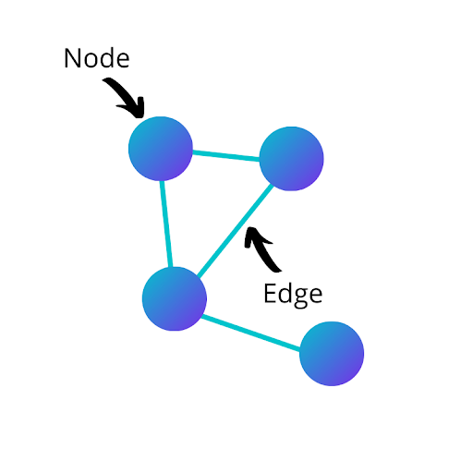
Cont ..

Slide 23
EDGE DIRECTION
There are two types of edges: directed and undirected. It will be necessary to translate what type of edge your data contains when building a network graph. Directed edges are applied from one node to another with a starting node and an ending node.
For example, when a Twitter user tags another Twitter user in a tweet, that relationship is directed. The user who wrote the tweet (starting node) applied that relationship to the user who they tagged (ending node).

Slide 24
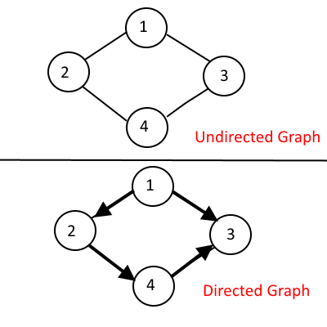

Slide 25
EDGE WEIGHT
An edge’s weight is the number of times that edge appears between two specific nodes.
For example, if person A buys a coffee from a coffee shop three times, the edge connecting person A and the coffee shop will have a weight of three. However, if person B only buys coffee from the coffee shop once, the edge connecting person B and the coffee shop will have a weight of one.

Slide 26
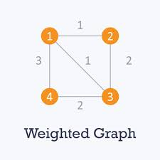

Slide 27
CENTRALITY MEASURES
Centrality is a collection of metrics used to quantify how important and influential a specific node is to the network as a whole. There are several centrality measures, like cover degree, closeness and betweenness, etc.,

Slide 28
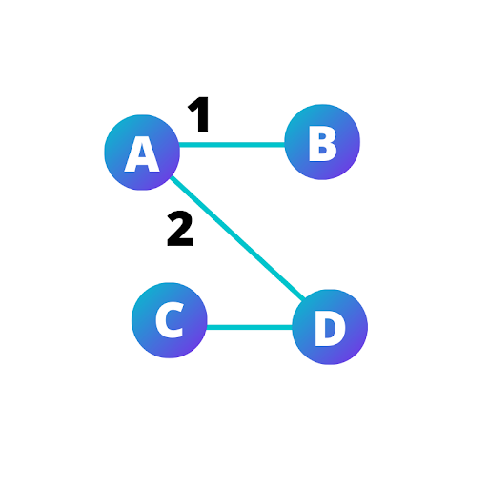
Degree
A node’s degree is the number of edges the node has. In an undirected network, there’s only one measure for degree.
For example, if node A has edges connecting it to node B and node D, then node A’s degree is two.

Slide 29
Cont ..
However, in a directed network, there are actually three different degree measures. Because these edges have a starting and end node, the in-degree (number of edges the node is an end node of), out-degree (number of edges a node is a starting node of), and degree (number of edges a node is either a starting node or end node of) can be calculated.

Slide 30
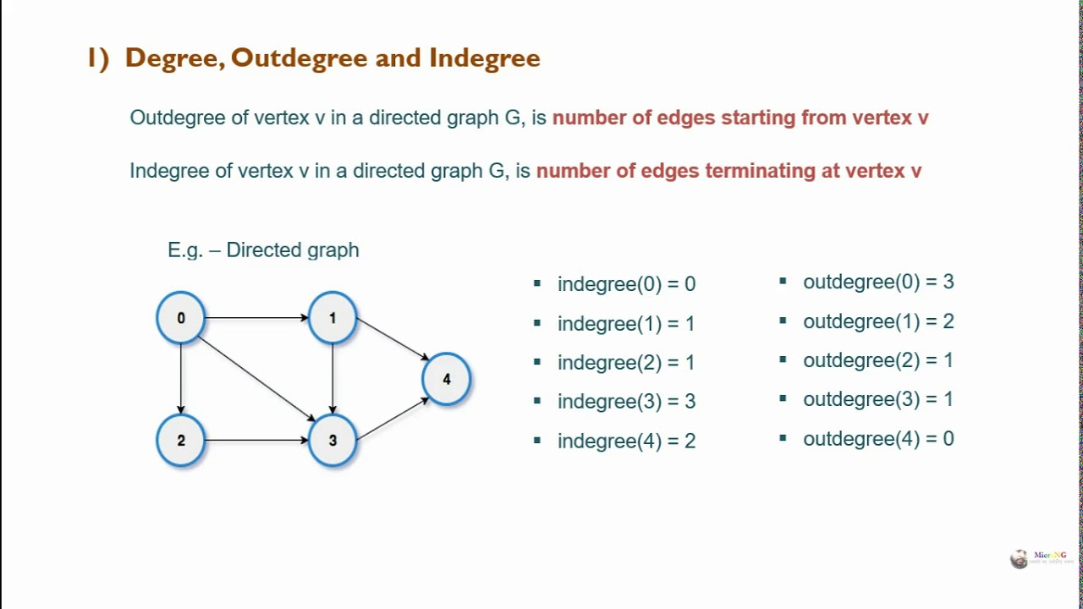

Slide 31
Closeness
Closeness measures how well connected a node is to every other node in the network. A node’s closeness is the average number of hops required to reach every other node in the network. A hop is the path of an edge from one node to another. For example, node A is connected to node B, and node B is connected to node C. For node A to reach node C it would take two hops.

Slide 32
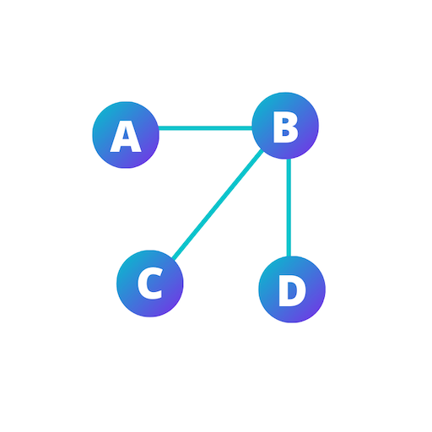

Slide 33
Betweenness
Betweenness measures the importance of a node’s connections in allowing nodes to reach other nodes (in a hop). A node’s betweenness is the number of shortest paths the node is included in divided by the total number of shortest paths. This will provide the percentage of shortest paths in the node’s network.

Slide 34
NETWORK-LEVEL MEASURES
We can also calculate metrics on the network level to evaluate the entire network instead of merely a single node. Like centrality measures, there are a variety of network-level measures like Network Size, Network Density.

Slide 35
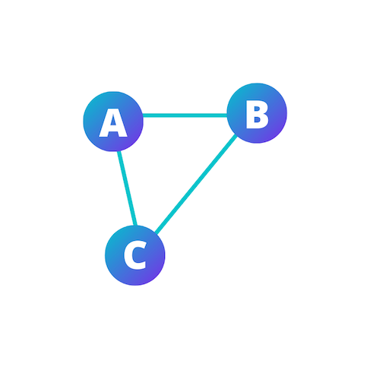
Network Size
Network size is the number of nodes in the network. The size of a network does not take into consideration the number of edges.
For example, a network with nodes A, B, and C has a size of three.

Slide 36

Network Density
Network density is the number of edges divided by the total possible edges.
For example, a network with node A connected to node B, and node B connected to node C, the network density is 2/3 because there are two edges out of a possible three.

Slide 37
PATH-LEVEL MEASURES
Path-level measures provide information for a path between one node and another node. Paths follow edges between nodes, known as hops. There are also many different path-level measures, but we’ll look at length and distance.

Slide 38
Length and Distance
Length
Length is the number of edges between the starting and ending nodes, known as hops. We must predetermine a path in order to calculate the length between two nodes.
Distance
Distance is the number of edges or hops between the starting and ending nodes following the shortest path. Unlike length, the distance between two nodes uses only the shortest path , path that requires the least hops.

Slide 39
CONNECTED COMPONENTS
Not all nodes in a network will necessarily be connected to each other. A connected component is a group of nodes that are connected to each other, but not connected to another group of nodes.
Another way of thinking of this is a group of connected nodes that have no path to a node from another group. Depending on the network, there can be many connected components, or even only one.

Slide 40
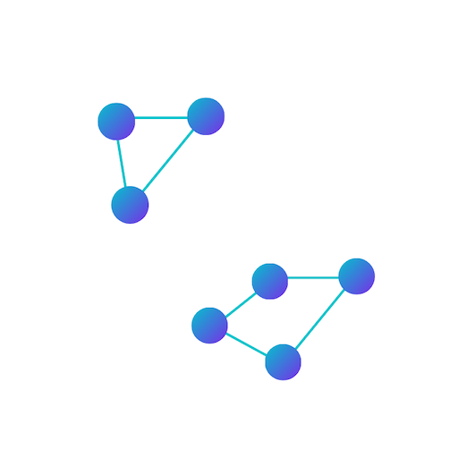
Example

Slide 41
Bridge
A bridge is a node that when removed, creates a connected component. Another way of thinking about it is that a bridge is a node that is the sole connection of a group of connected nodes to another group of connected nodes.

Slide 42
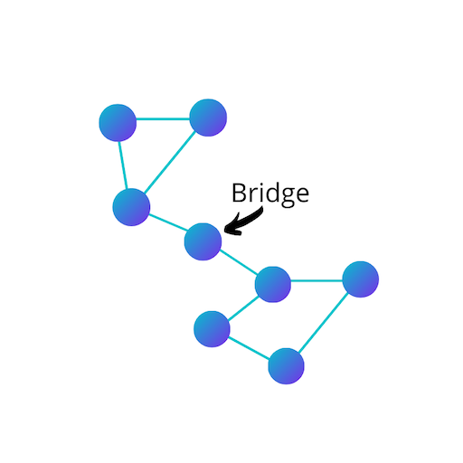
Example

Slide 43
HUBS AND AUTHORITIES
Hubs and Authorities are node classifications used in directed networks. A hub is a node that has many edges pointing out of it. You can also think of a hub as a node that’s the starting node of many edges.
An authority, on the other hand, is a node that has many edges pointing to it. You can also think of authority as a node that is the ending node of many edges. There’s not a pre-determined number of edges that makes a node a hub or an authority; it will depend on the network. In addition, remember that not all nodes in a directed network will be a hub or an authority.

Slide 44
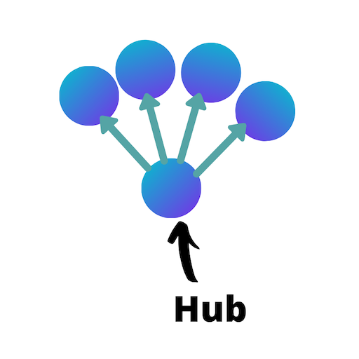
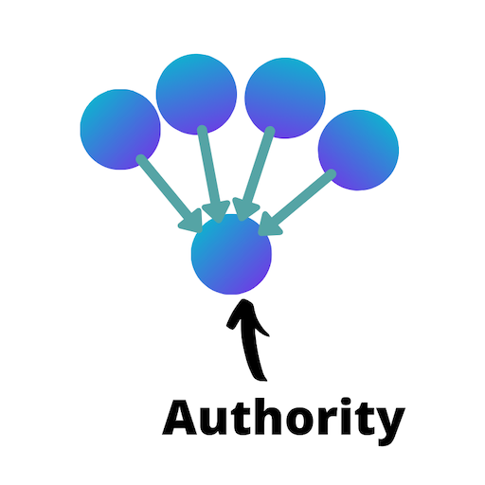
Example

Slide 45
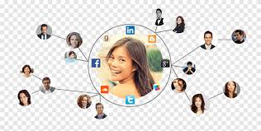
Social Networks as Graphs
Social networks are naturally modeled as graphs, which we sometimes refer to as a social graph.

Slide 46
Social Network Graph
A social network graph is a graph where the nodes represent people and the lines between nodes, called edges, represent social connections between them, such as friendship or working together on a project. These graphs can be either undirected or directed. For instance, Facebook can be described with an undirected graph since the friendship is bidirectional, Alice and Bob being friends is the same as Bob and Alice being friends. On the other hand, Twitter can be described with a directed graph: Alice can follow Bob without Bob following Alice.

Slide 47
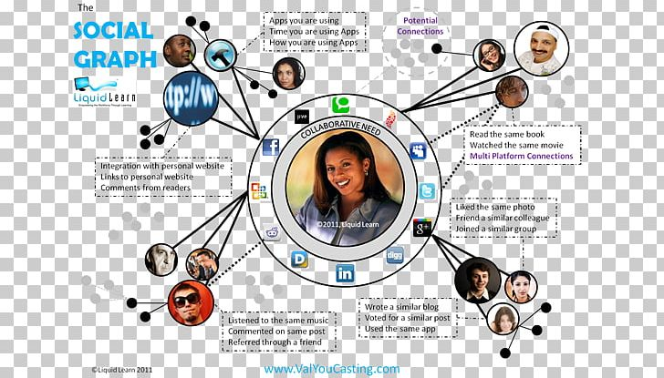

Slide 48
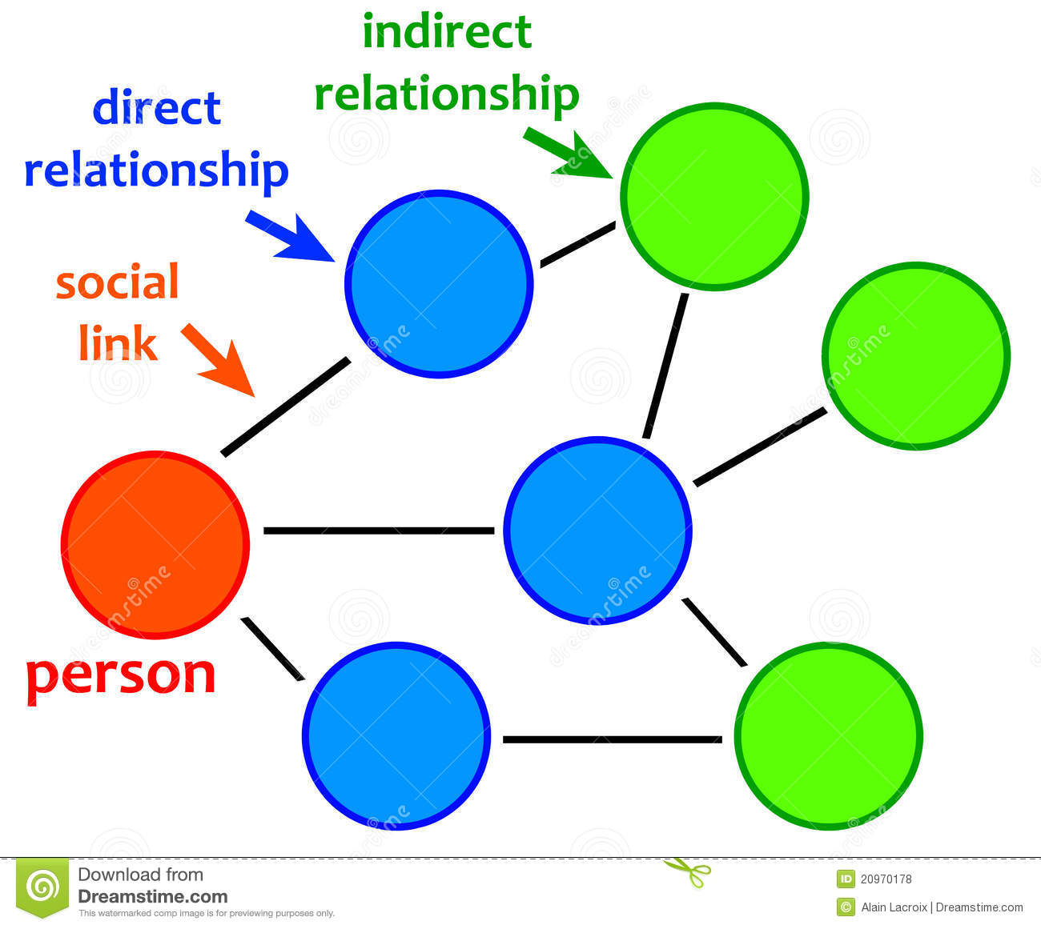

Slide 49
Matrix
A set of numbers arranged in rows and columns so as to form a rectangular array. The numbers are called the elements, or entries, of the matrix. Matrices have wide applications in engineering, physics, economics, and statistics as well as in various branches of mathematics.

Slide 50
Matrix Representation of the Network
Every network can be expressed mathematically in the form of an adjacency matrix. In these matrices the rows and columns are assigned to the nodes in the network and the presence of an edge is symbolized by a numerical value.
By using the matrix representation of the network we can calculate network properties such as degree, and other centralities by applying basic concepts from linear algebra.
A network with undirected, unweighted edges will be represented by a symmetric matrix containing only the values 1 and 0 to represent the presence and absence of connections, respectively. Directed and weighted networks can make use of different numerical values in the matrix to express these more complex relationships.

Slide 51
Adjacency Matrix
The adjacency matrix, sometimes also called the connection matrix, of a simple labeled graph is a matrix with rows and columns labeled by graph vertices, with a 1 or 0 in position according to whether and. are adjacent or not.
For a simple graph with no self-loops, the adjacency matrix must have 0s on the diagonal.

Slide 53
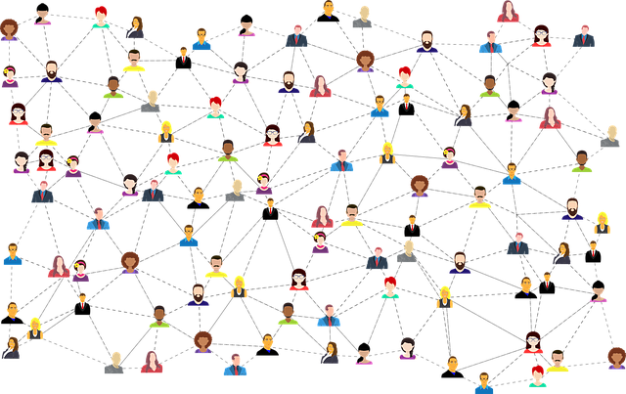
Facebook Network

Slide 58
Social Networks Analysis Measures
Different performance measures that are encountered during any network analysis in order to understand the fundamental concepts.
The most important concepts used in network analysis are closeness, network density, centrality, betweenness and centralization.

Slide 59
Closeness

Slide 60
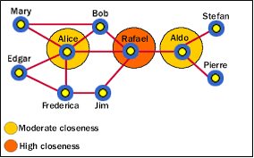

Slide 61
Network Density
Network density is a measure of the connectedness in a network. Density is defined as the actual number of ties in a network, expressed as a proportion of the maximum possible number of ties.
It is a number that varies between 0 and 1.0. When density is close to 1.0, the network is said to be dense, otherwise it is sparse. When dealing with directed ties, the maximum possible number of pairs is used instead.
The problem with the measure of density is that it is sensitive to the number of network nodes; therefore, it cannot be used for comparisons across networks that vary significantly in size.

Slide 62
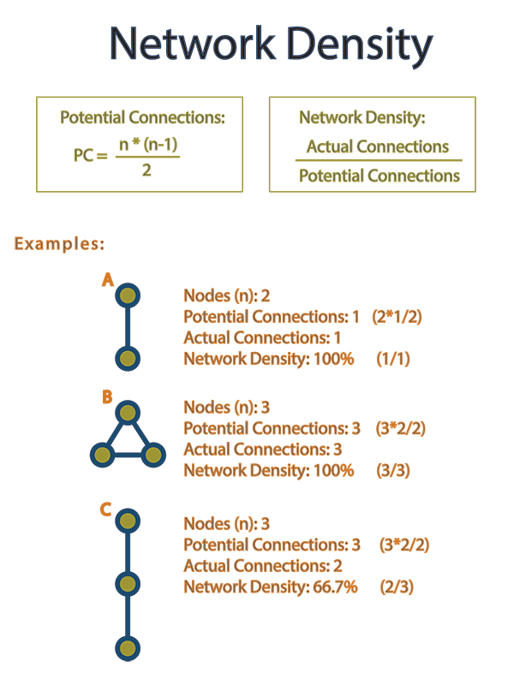

Slide 63
Centrality: Local and Global
The concept of centrality comprises two levels: local and global.
A node is said to have local centrality, when it has a higher number of ties with other nodes, otherwise it is referred to as a global centrality.
Whereas local centrality considers only direct ties (the ties directly connected to that node), global centrality also considers indirect ties (which are not directly connected to that node).

Slide 64
Cont ..
The shortest distance between two points on the surface of the earth lies along the geodesic that connects them, and, by analogy, the shortest path between any particular pair of nodes in a network is termed a geodesic.
A node is globally central if it lies at a short distance from many other nodes. Such a node is said to be “close” to many of the other nodes in the network, sometimes global centrality is also called closeness centrality.
Local and global centrality depends mostly on the size of the network, and therefore they cannot be compared when networks differ significantly in size.

Slide 65
Cont ..
For example, in a network with a “star” structure, in which, all nodes have ties with one central node, local centrality of the central node is equal to 1.0.
Whereas local centrality measures are expressed in terms of the number of nodes to which a node is connected, global centrality is expressed in terms of the distances among the various nodes.
Two nodes are connected by a path if there is a sequence of distinct ties connecting them, and the length of the path is simply the number of ties that make it up.

Slide 66
Betweenness
Betweenness is defined as the extent to which a node lies between other nodes in the network.
Here, the connectivity of the node’s neighbours is taken into account in order to provide a higher value for nodes which bridge clusters. This metric reflects the number of people who are connecting indirectly through direct links.
The betweenness of a node measures the extent to which an agent (represented by a node) can play the part of a broker or gatekeeper with a potential for control over others.

Slide 67
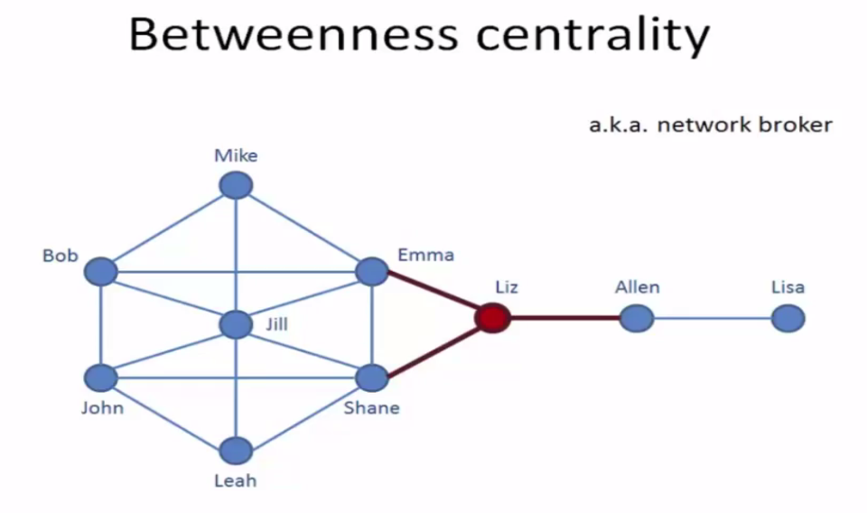

Slide 68
Centralization
Centralization is calculated as the ratio between the numbers of links for each node divided by the maximum possible sum of differences.
Centralization provides a measure of the extent to which a whole network has a centralized structure.
Whereas centralization describes the extent to which this connectedness is organized around particular focal nodes; density describes the general level of connectedness in a network.

Slide 69
Cont ..
Centralization and density, therefore, are important complementary pair measures.
While a centralized network will have many of its links dispersed around one or a few nodes, the decentralized network is one in which there is little variation between the number of links each node possesses.

Slide 70
Ego-Centric Networks
Ego-centric networks (or shortened to “ego” networks) are a particular type of network which specifically maps the connections of and from the perspective of a single person (an “ego”).
For example, if you were to ask someone to name their friends (or any other type of “alter,” which is defined as someone who is not the ego), they will tell you who their friends are.

Slide 71
Cont ..
There are many ways that you can create an egocentric network.
One is a star that shows simply ego and all of ego's alters (a 1.0 degree network).
Another is a network that includes the ties between these friends (a 1.5 degree network).
A 2.0 degree network includes all of alter's other connections, and not just connections to people that ego knows.

Slide 72
2.0 degree network
1.0 degree network
1.5 degree network

Slide 73
Social Media Data Visualization
Social media professionals know that sharing visual content yields higher levels of engagement, and that means increased brand awareness, improved marketing reach, and increased ROI.
Having access to vast amounts of data often gives marketers a hard time picking what they need to measure performance, thus leaving them confused and not able to make any decisions.
By using data visualization, they can increase the quality and speed of their social media marketing decisions. They’ll be able to understand massive amounts of information better, make informed decisions, as well as present the results to clients, executives, or managers in a clear and pleasant-to-look manner.

Slide 74
What is Data Visualization?
It is the graphical representation of data by using graphs, charts, maps, and other visual elements that can be easily interpreted by everyone. In a way, it’s a type of visual art that attracts people’s attention and keeps their eyes on the most important message.
Data visualization helps decision-makers understand difficult concepts or discover new patterns. The most common forms include:
• Bar charts • Line charts • Area charts • Pie charts
• Histograms • Scatter plots • Heat maps
It’s important to use the right type of data visualization that will help you point out and clarify the takeaways from your data instead of confusing others even more.

Slide 75
3 Steps of Social Media Analytics
1. Capturing – determining a particular goal and capturing data to measure your social media key performance indicators (KPIs).
2. Comprehending – determining the most effective tactics on particular networks. An audience that doesn’t interact with your content means that you have to improve your strategy.
3. Presenting – Once you understand your data, the next step is to visualize it and present it.

Slide 76
Social Media KPIs
Likes
Followers growth
Traffic conversions
Social interactions
Social sentiment
Social shares
Web visitors by channel source
Social visitors conversion rate

Slide 77
How to visualize social media data
When it comes to presenting social media data, here are the best tips that are worth remembering:
1. Know your audience
2. Know your graphs
3. Don’t use just any color
4. Make it simple
5. Use the right tools

Slide 78
Know your Audience
Adapt your presentation to your target audience, whether it's executives, coworkers, or stakeholders. This is crucial if you want to engage them effectively. It’s similar to knowing your audience on social media so that you can deliver the right content for them and ensure high engagement.
Think about your audience when creating visual formats to present your social media data. For example, you wouldn’t like to overwhelm your executives with information as you already know that they are busy.
As you can see, knowing your audience can help you tackle the right data that will be interesting and relevant to them. Avoid overwhelming them with information even if you present the most relevant data. Also, make sure you have an idea of the story you want to share.

Slide 79
Know your Graphs
Each graph is created to present data in a specific way, so it’s only logical that some of them are better than others. Take a look at the different types of graphs and their common usage:
• Scatter plot – this type of graph shows a correlation.
• Pie chart – this one shows proportions.
• Line graph – use this graph to present trends and patterns.
• Table – this type of graph is perfect for presenting specific values.
• Bar chart – this one is excellent for showing comparisons.

Slide 80
Don’t use just any Color
When it comes to colors, it’s best to start your graphs in black and white, and then gradually add colors when needed. Even though using many different colors is fun and can make the graphs look entertaining, it can be counterproductive.
That’s because a graph with too many colors can distract your audience and confuse them instead of helping them understand the information presented. The purpose of graphs is to present the information as clearly as possible, and colorful graphs don’t deliver this impression.
Therefore, you may want to know the following things when using colors in your graphs:
• Avoid red whenever possible – This color has a negative connotation for you. When people see red, they instantly connect it to something bad or wrong, even if it’s used to point out something positive, like a rise in Facebook engagement.

Slide 81
Cont ..
• Color gradients for time series – you can use the lightest to darkest shades of one color to present certain data from the past to the present. Fading colors can signify less relevant information as the years go by.
• Highlight – if you want to point out a specific value so that everyone notices it, use a strong hue. You can use it, for example, to highlight a surge in click- throughs.
• Assign value to each color – if you want to represent a range with the help of colors, choose colors and give each of them a specific value. For instance, yellow for anything over 80%, and blue for anything below 20%.
• Use color to present a group of relevant data – use one color, for example, blue for Facebook or orange for Instagram, to group relevant social media data together.
• Use brand colors – in this way, you’ll avoid using too many colors and making the graph confusing.

Slide 82
Make it Simple
When it comes to presenting your data in a visual format, it’s important to consider the user's experience. To provide data insights effectively, you’ll have to take an audience-centric approach.
For that purpose, take the following things into consideration:
• Left to right – that’s how our minds work, especially when we see charts that compare values. Therefore, present the values in a descending or ascending order to ensure easy comparison.
• Do the job for your audience – this includes sorting data into a logical order, grouping relevant values together, and highlighting important parts.
• Do not focus on the aesthetics too much – avoid using too many colors, even if that will make your graph more vibrant and attractive. Don’t use a pie chart when you can just write out numbers.
• Less is more – don’t use logos, imagery, and clipart as that will only make your presentation confusing. Keep it simple.

Slide 83
Use the Right Tools
There are numerous data visualization tools available, but using the right one, such as Whatagraph, can assist you in making sense of your data and clearly presenting social media metrics so that your audience understands them easily.

